Slide 1
TUN Project
Andrew Phillips, Maida Muminovic, Kazi Islam, Ni Shu

Slide 2

Summary
Who is Hire Heroes?
What services do they offer?
Our analytical focus: Donations

Slide 3

Problem and Motivation
Where did most donations come from?
Where did few or no donations come from?
Advertising Reach
Donation Grouping

Slide 4

Approach
Donations are crucial for non-profits.
Various donation routes.
Analyzing 2 main avenues:
Donation Medium
Donation Locations

Slide 5

Datasets
Primary Datasets:
SalesForce_Opportunity
SalesForce_Account
Data Dictionary for References
Searched for the key term “Donate”.
And focused on the Stay Classy Data
Findings:
Donations and Fundraisers
Amount Given
Event Type

Slide 6
Tools and Analytics
Tableau
Clean the data.
Remove null values
Remove unneeded columns
Present the data.
Classy.com
Quantity given per year.
States donated from.

Slide 7
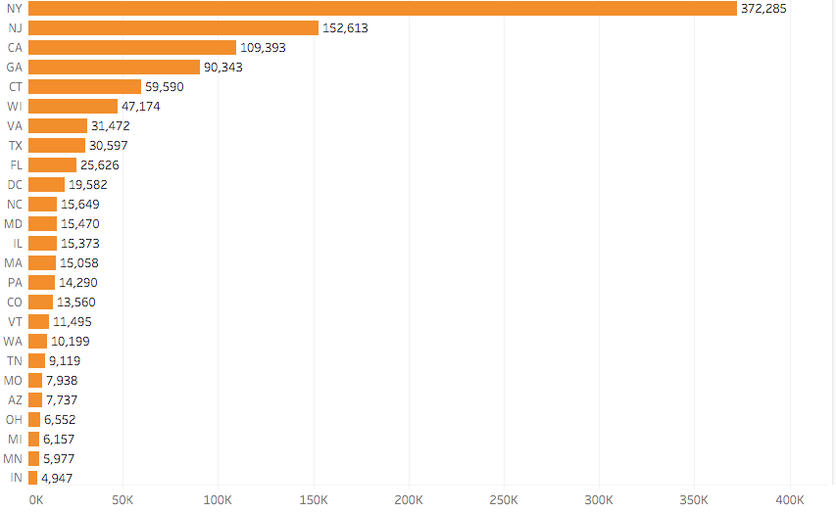
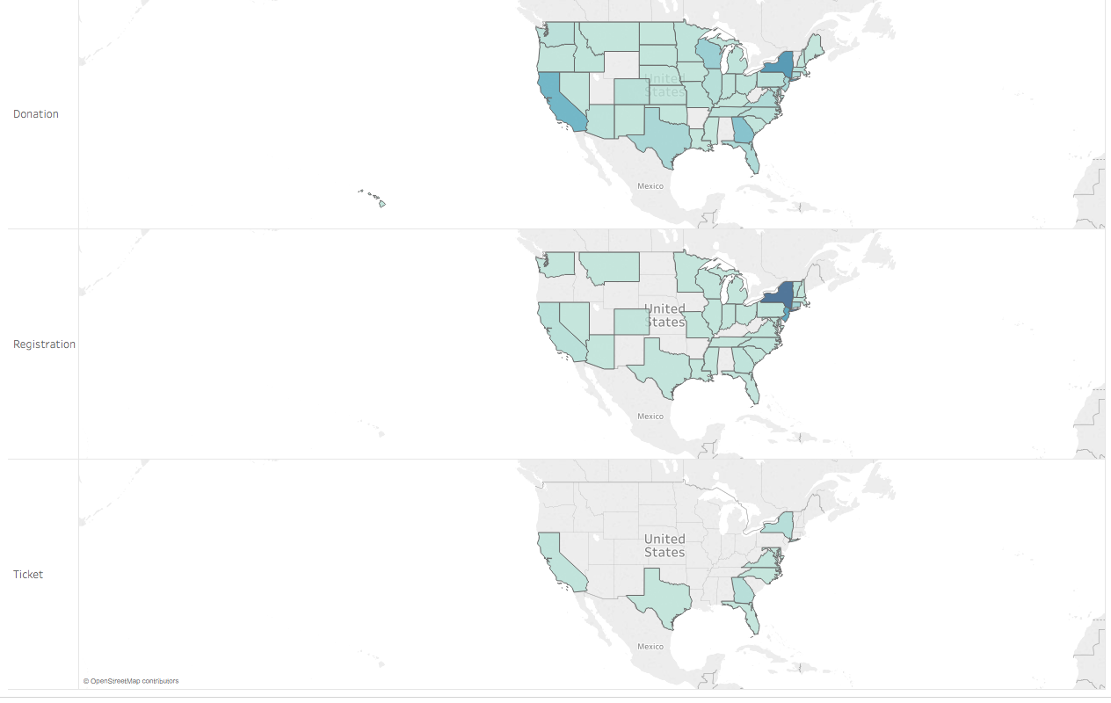
Results (Overview)
Total Donations in Each State Based on Event Type

Slide 8
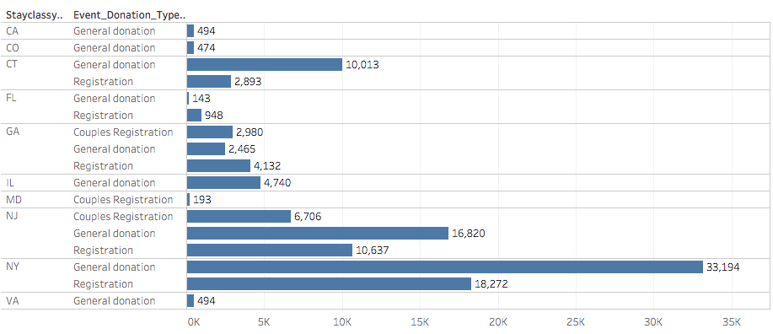
Total Donations Based on Event
Provided a detail report of the states that contributed in donations
Can clearly see which states donated the most with
New York donating the most
Clearly can see that most of the donations
came from a general donation

Slide 9
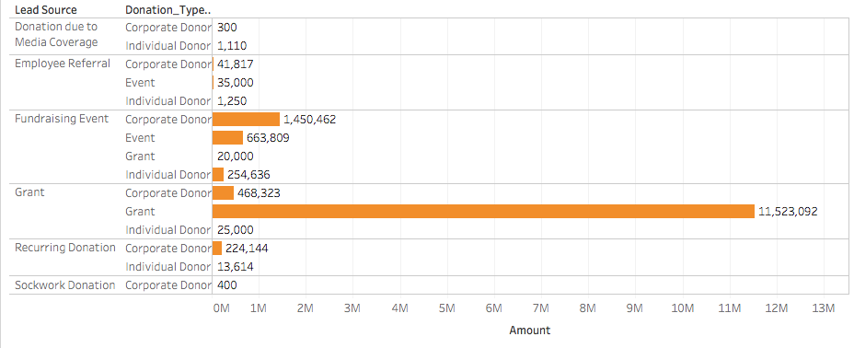
Lead Source
We noticed a distinct comparison that donation due to media coverage was only very slight compared to that of fundraising.
Comparing and viewing the results in this sense gave us an overview as to where the total of donations were coming from.

Slide 10
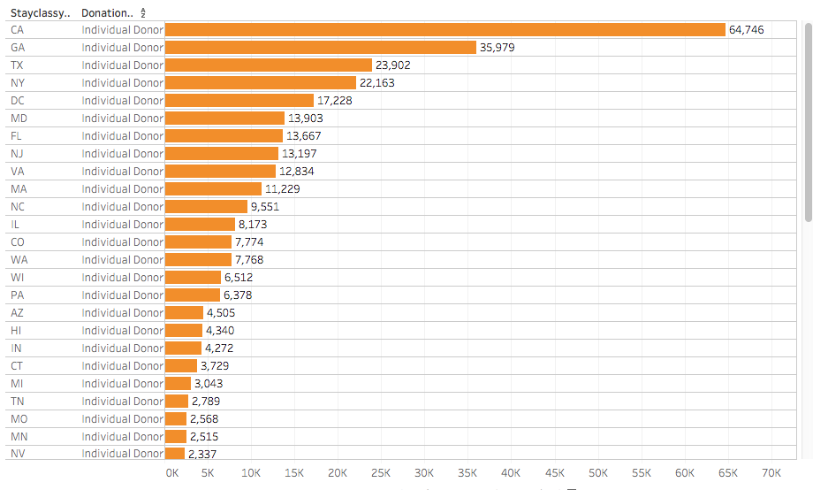
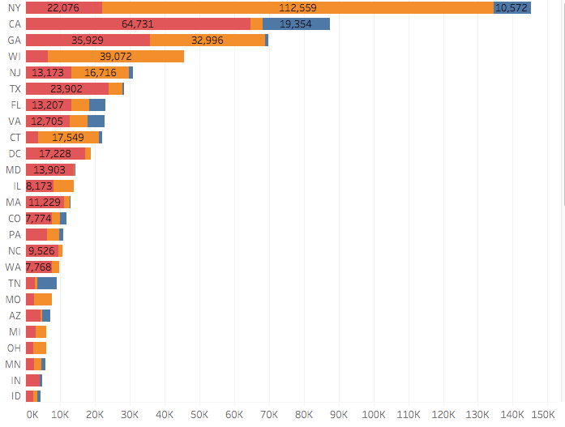

Results - States with the Most Individual Donors
Our results concluded that although New York had the most donations, California proved to receive the most individual donors.
Is there a geographic location within the US that most of our individual donors come from?

Slide 11
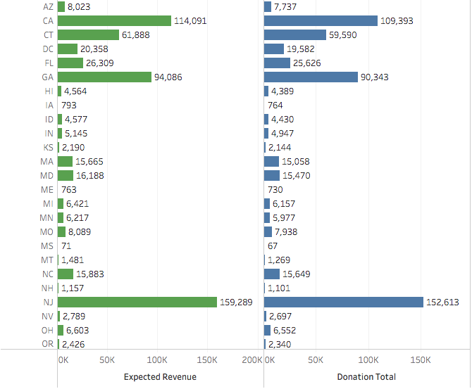
Expected Revenue vs. Donation Total
We can clearly see a slight difference in the
total donated with the what was expected
However we can note that states like
New York & California were expected to raise
a very high amount in donations

Slide 12
Citations
https://dab1nmslvvntp.cloudfront.net/wp-content/uploads/2015/07/1437062927idea.jpg
https://d6dyoorq84mou.cloudfront.net/uploads/tenant/logo/5214/HHUSA_Horizontal_Logo_TM.png
https://cdn.lynda.com/course/664827/664827-636903187108128765-16x9.jpg
https://upload.wikimedia.org/wikipedia/en/thumb/8/83/Salesforce_logo.svg/1200px-Salesforce_logo.svg.png

